Slide 1
Version control for researchers with Git and GitHub
Karin Knudson
karin.knudson@tufts.edu

Slide 2
Why use Git and GitHub?
Sleep better at night with version control and remote repositories
Collaborate smoothly with teammates
Promote and maintain quality in your code
Increase the impact of your research
Develop your career
Contribute in the open source community

Slide 3
After this workshop you should be able to…
Explain how version control, Git, and GitHub can help you and your team
Create a new project that is tracked with Git, or add Git to an existing project
Use a simple workflow with Git and GitHub that is useful for small or individual projects
Use a more complex workflow with branches and pull requests
Contribute to some else’s open source project on GitHub
Know where to go to learn more

Slide 4
Git vs. GitHub
Git = software for version control
Will learn to use basic Git commands: init, remote, fetch, merge, status, add, commit, merge, push, fetch, checkout
GitHub = a repository hosting service with a graphical interface and additional tools for collaboration and more
Will learn to put repositories on GitHub, collaborate when others’ have GitHub repositories, use GitHub pull requests.
Other options: e.g. BitBucket

Slide 5
Set up a new repository with Git and GitHub
Initialize with git init
Connect your repository to a remote GitHub repository with GitHub’s interface and git remote add
Copy the content you created to your remote repository (hosted on GitHub) with git push
GitHub
local repository
remote repository
(often called origin)
push

Slide 6
Follow the numbered instructions in parts I and II
https://xkcd.com/1656/

Slide 7
git + command + flags/arguments
git push -u origin master
git fetch origin
git merge origin master
git add hello.py

Slide 8
fetch
(write and edit code)
fetch
local
remote
(origin)
local
remote
(origin)
merge
status
merge
add
push
local
remote
(origin)
commit

Slide 9
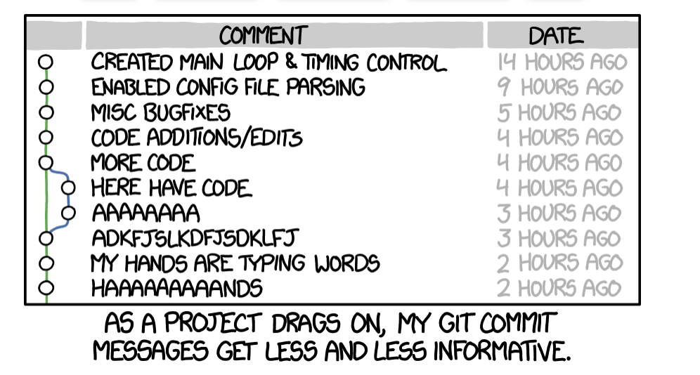
Follow the instructions in part III to practice the workflow now
https://xkcd.com/1296/

Slide 10
Merge conflicts
If you and a collaborator are simultaneously changing different parts of the code and merging, no problem!
If you change a line of code, and in the meantime some one has made a different change to the same line and pushed those changes, you can have a merge conflict.

Slide 11
Use Git branches and GitHub pull requests
Instead of making all changes to master branch, create different branches for different features you develop.
Make branches locally, and then create and connect them to corresponding remote branches.
Once your feature-specific branch is where you want it to be, then merge the changes on this branch back into the master branch of the remote repository.
Use GitHub’s pull requests to get collaborator’s consent and input before merging the code on feature branch into the master branch of the remote repository.
Move between branches with the checkout command
(caution: git checkout <filename> is dangerous).
Image source: https://wac-cdn.atlassian.com/dam/jcr:83323200-3c57-4c29-9b7e-e67e98745427/Branch-1.png?cdnVersion=jt

Slide 12
Move between branches with the checkout command
(CAUTION: git checkout <filename> is dangerous).

Slide 13
Follow the instructions in part V to practice the workflow now
https://xkcd.com/1597/

Slide 14
Using GitHub forks to build on someone else’s repository
Someone else’s GitHub
remote
(upstream)
fetch and merge changes
from upstream to stay
up-to-date with original project
Use a pull request to
ask the other person to
include your changes
local
fork on GitHub to copy
push changes
Your GitHub
edit and commit changes
remote
(origin)
remote
(origin)
clone to make a
local copy of
the repository

Slide 15
“Homework”
Contribute to https://github.com/karink520/TuftsGitHubSampleToUpdate using the process above as outlined in part VI.

Slide 16
Some other important topics
Stashing changes
Undoing changes and reverting
See what has changed with git diff
Ignoring files you don’t want to track
Use ssh to connect to GitHub
GitHub actions (e.g. to automatically run tests or other checks)
(see part VII)

Slide 17
Resources (part VIII)
•Searches and StackOverflow
•DangitGit!? https://dangitgit.com/
•GitHub Guides https://guides.github.com/introduction/git-handbook/
•Browser game for learning about Git branching https://learngitbranching.js.org/
•“A minimal tutorial”: https://kbroman.org/github_tutorial
• Atlassian tutorials https://www.atlassian.com/git/tutorials
and Git “cheat-sheet” https://www.atlassian.com/git/tutorials/atlassian-git-cheatsheet)
•MIT CSAIL's "Missing Semester" lesson on Git: https://missing.csail.mit.edu/2020/version-control/
Office hours:

Slide 18
Questions??

